Slide 1
ML Project (SVM and Decision Tree)
By Suryanarayan.B

Slide 2

Decision Trees
Decision Tree is a Supervised learning technique that can be used for both classification and Regression problems, but mostly it is preferred for solving Classification problems. It is a tree-structured classifier, where internal nodes represent the features of a dataset, branches represent the decision rules and each leaf node represents the outcome.
In a Decision tree, there are two nodes, which are the Decision Node and Leaf Node. Decision nodes are used to make any decision and have multiple branches, whereas Leaf nodes are the output of those decisions and do not contain any further branches.

Slide 3
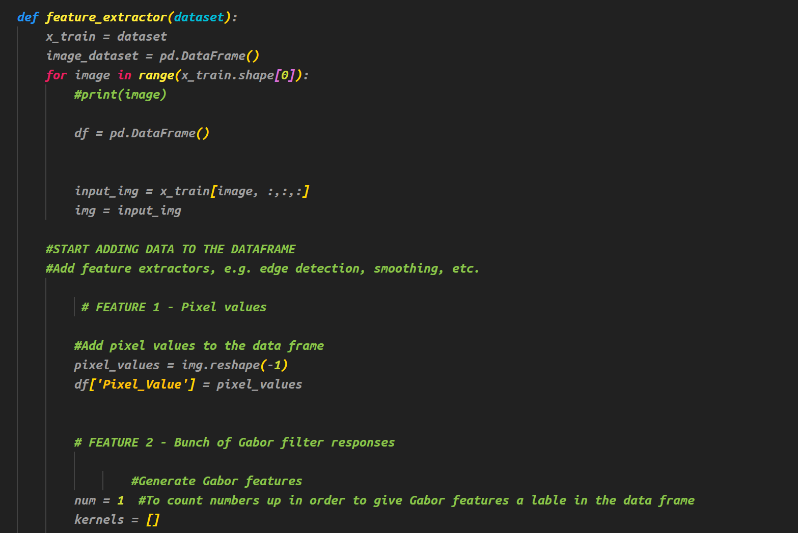
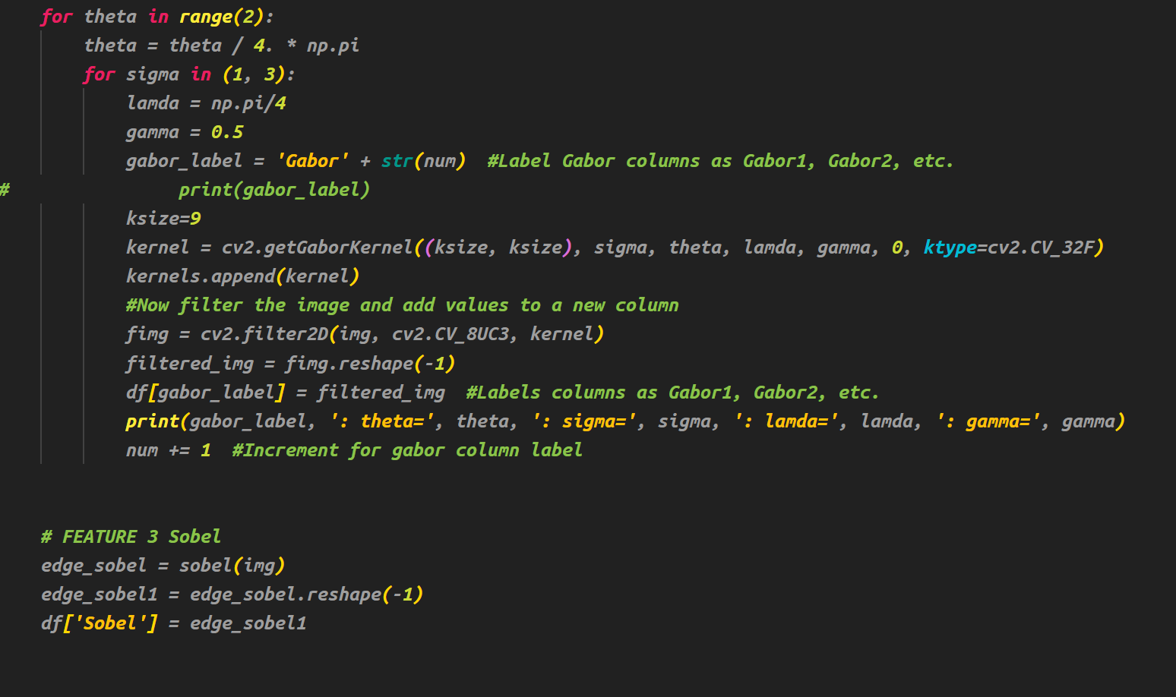
Image Preprocessing using Opencv
Here we use gaussian filter and
Sobal Edge detection for Image

Slide 4
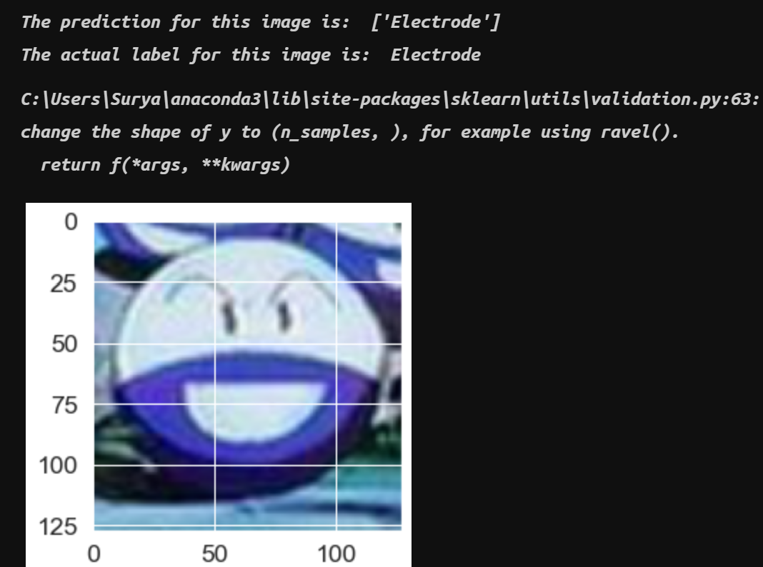

Accuracy
The Accuracy we got after the implementation is 23%
Predicted Image:
Decision trees are unstable, meaning that a small change in the data can lead to a large change in the structure of the optimal decision tree. They are often relatively inaccurate.
Due to this this isn’t an efficient algorithm for Image Identification

Slide 5
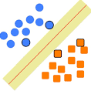
SVM(Support Vector Machine)
Support Vector Machine or SVM is one of the most popular Supervised Learning algorithms, which is used for Classification as well as Regression problems. However, primarily, it is used for Classification problems in Machine Learning.

Slide 6

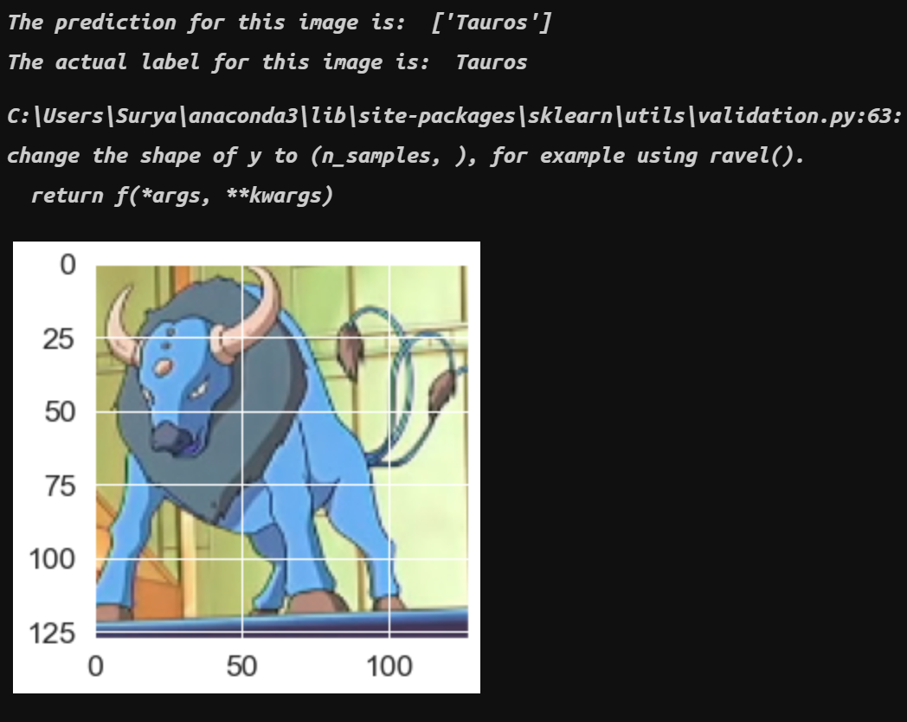
Using Classical Method
Accuracy:
Predicted Image:
In the classical method we use gaussian filter and Sobal edge detection to preprocess the image
The accuracy we get from SVM using sklearn is 36.98%
SVM can also be done using Tensorflow
Next slide explains about the implementation of SVM using tensorflow

Slide 7
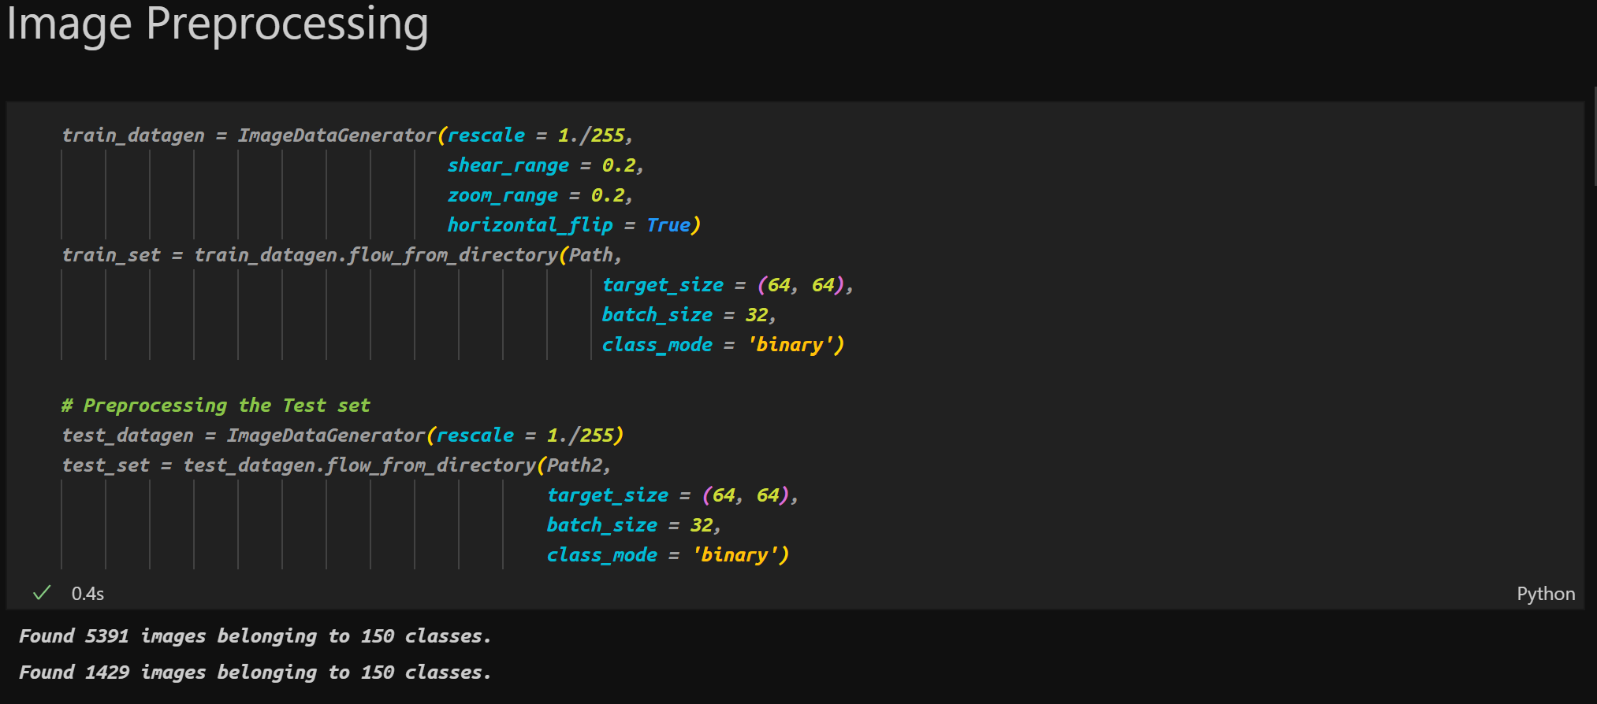
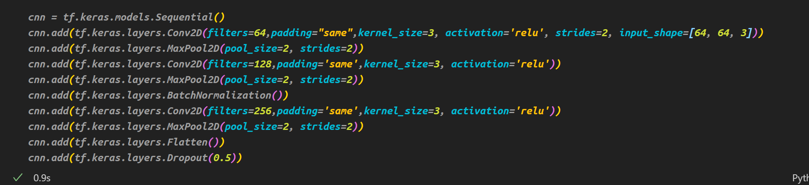

Using Advanced Method
We used Tensorflow to
Implement SVM and applied Feature Extraction and Dimensionality reduction
The accuracy obtained is 81.73%

Slide 8
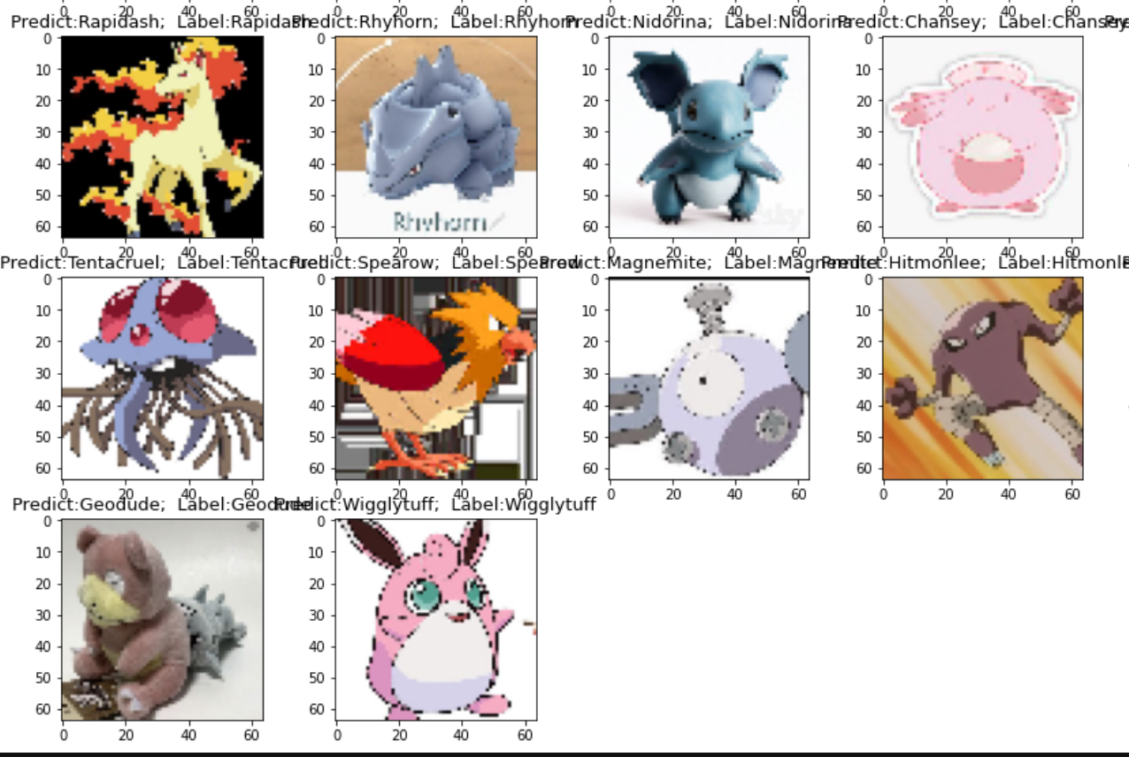
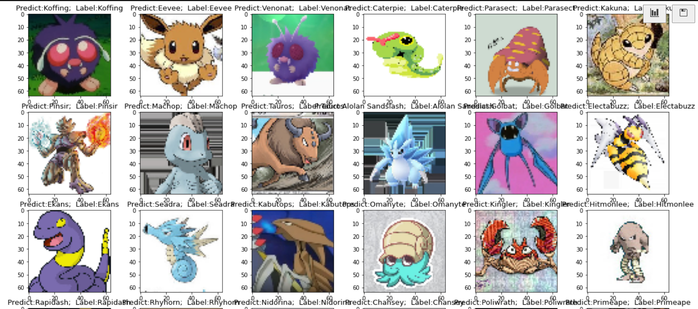
The Predicted Model

Slide 9
Conclusion
Comparing the two models we conclude that the model which is trained using Tensorflow and CNN not only gives a better accuracy score but also better prediction than the model which is trained through sklearn

